Slide 1
Non-type template parameter
A non-type template parameter is a template parameter with a fixed type that serves as a placeholder for a constexpr value passed in as a template argument.
A non-type template parameter can be any of the following types:
An integral type
An enumeration type
std::nullptr_t
A pointer or reference to an object or a function
A pointer or reference to a member object or function
A floating point type (since C++20)
Array and function types may be written in a template declaration, but they are automatically replaced by pointer to object and pointer to function as appropriate.
std::bitset is an example of using non-type template parameter.
#include <bitset>
int main() {
// The <8> is a non-type template parameter
std::bitset<8> bits{ 0b0000'0101 };
return 0;
}

Slide 2
Non-type template parameter
A non-type template parameter is a template parameter with a fixed type that serves as a placeholder for a constexpr value passed in as a template argument.
#include <iostream>
using namespace std;
template<int N> // N will be evaluated at compile time
void printIntAsBits(int n) {
for (int i = N - 1; i >= 0; i--) {
cout << ((n >> i) & 1);
}
cout << endl;
}
void printIntAsBits(int x, int N) { // N will be evaluated at runtime
for (int i = N - 1; i >= 0; i--) {
cout << ((x >> i) & 1);
}
cout << endl;
}
int main() {
printIntAsBits<32>(-1);
return 0;
}
Notes:
o

Slide 3
Function pointer
Functions are stored in the read-only code segment (text segment) of memory.
When calling a function, the IP (instruction pointer) will jump to the function address.
-> You can also use pointer to point to a function’s address -> function pointer
#include <iostream>
int foo(){
return 5;
}
int main() {
std::cout << reinterpret_cast<void*>(foo) << '\n';
return 0;
}
Notes:
o

Slide 4
Function pointer
Function pointer declaration is quite hard to read
A function pointer can be assigned by any function that match the parameter types and return type
You can call function pointer as other normal functions (implicit) or explicit dereference it before calling.
Default arguments don’t work for functions called through function pointers
<return_type> (*<name_of_ptr>)(<data_type_of_parameters>);
#include <iostream>
void foo(int a) {
std::cout << "foo: " << a << std::endl;
}
void bar(int a) {
std::cout << "bar: " << a << std::endl;
}
int main() {
void (*f)(int);
f = foo;
f(1);
f = bar;
f(2);
return 0;
}
#include <iostream>
void foo(int a) {
std::cout << "foo: " << a << std::endl;
}
void bar(int a) {
std::cout << "bar: " << a << std::endl;
}
int main() {
void (*f)(int);
f = foo;
(*f)(1);
f = bar;
(*f)(2);
return 0;
}
Notes:
o

Slide 5
Function pointer
Remember that we have type alias
#include <iostream>
using FuncVoidInt = void (*)(int);
void foo(int a) {
std::cout << "foo: " << a << std::endl;
}
void bar(int a) {
std::cout << "bar: " << a << std::endl;
}
int main() {
FuncVoidInt f;
f = foo;
f(1);
f = bar;
f(2);
return 0;
}
Notes:
o

Slide 6
Function callback
Functions used as arguments to another function
Can be implemented by:
Function pointer
Function template
Function in <functional> header
Notes:
o

Slide 7
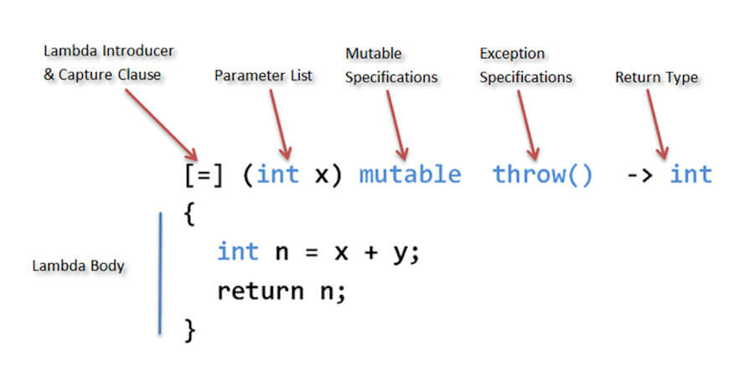
Anonymous function (lambda)
A lambda expression allows us to define an anonymous function (unnamed) as close to where it is used as possible.
Notes:
o

Slide 8
Anonymous function (lambda)
#include <iostream>
using namespace std;
void stdio_doing(int n) {
n = n + 10;
cout << n << " ";
}
void for_each(int *arr, int n, void (*func)(int a)){
for (int i = 0; i < n; i++) {
func(*(arr + i));
}
}
int main() {
int n = 5;
int arr[] = {1, 2, 3, 4, 5};
for_each(arr, n, stdio_doing);
return 0;
}
#include <iostream>
using namespace std;
void for_each(int *arr, int n, void (*func)(int a)){
for (int i = 0; i < n; i++) {
func(*(arr + i));
}
}
int main() {
int n = 5;
int arr[] = {1, 2, 3, 4, 5};
for_each(arr, n, [](int a) {
a = a + 10;
cout << a << " ";
});
return 0;
}
Notes:
o

Slide 9
Anonymous function (lambda) – capture clause
Notes:
o

Slide 10
Function callback
Using function pointer
#include <iostream>
#include <vector>
using namespace std;
using CompareFunc = bool (*)(int, int);
void simpleSort(vector<int> &arr, CompareFunc compare) {
for (int i = 0; i < arr.size(); i++) {
for (int j = i + 1; j < arr.size(); j++) {
if (compare(arr[i], arr[j])) {
swap(arr[i], arr[j]);
}
}
}
}
bool compareAsc(int a, int b) {return a > b;}
bool compareDesc(int a, int b) {return a < b;}
int main() {
vector<int> arr = {1, 3, 5, 7, 9, 2, 4, 6, 8, 10};
simpleSort(arr, compareAsc);
return 0;
}
Notes:
o

Slide 11
Function callback
Using function template
#include <iostream>
#include <vector>
using namespace std;
template<typename CompareFunc>
void simpleSort(vector<int> &arr, CompareFunc compare) {
for (int i = 0; i < arr.size(); i++) {
for (int j = i + 1; j < arr.size(); j++) {
if (compare(arr[i], arr[j])) {
swap(arr[i], arr[j]);
}
}
}
}
bool compareAsc(int a, int b) {return a > b;}
bool compareDesc(int a, int b) {return a < b;}
int main() {
vector<int> arr = {1, 3, 5, 7, 9, 2, 4, 6, 8, 10};
simpleSort(arr, compareAsc);
return 0;
}
Notes:
o

Slide 12
Function callback
Using function in functional
#include <iostream>
#include <vector>
#include <functional>
using namespace std;
void simpleSort(vector<int> &arr, function<bool(int, int)> compare) {
for (int i = 0; i < arr.size(); i++) {
for (int j = i + 1; j < arr.size(); j++) {
if (compare(arr[i], arr[j])) {
swap(arr[i], arr[j]);
}
}
}
}
bool compareAsc(int a, int b) {return a > b;}
bool compareDesc(int a, int b) {return a < b;}
int main() {
vector<int> arr = {1, 3, 5, 7, 9, 2, 4, 6, 8, 10};
simpleSort(arr, compareAsc);
return 0;
}
Notes:
o

